Slide 1




Techlators
Home
Service
About Us
Contact
TECHLATORS
SIYABONGA DHLAMINI
MPHO HLATSHWAYO
MANDLA NYEMBE
NEO SEKGALA
NOMBUYISELO KHUMALO

Slide 2

Techlators
Home
Service
About Us
Contact
OSI MODEL
The International Organization for Standardization developed the Open Systems Interconnection (OSI) model, a conceptual framework that separates network communications functions into seven layers and allows various communication systems to communicate using common protocols.

Slide 3
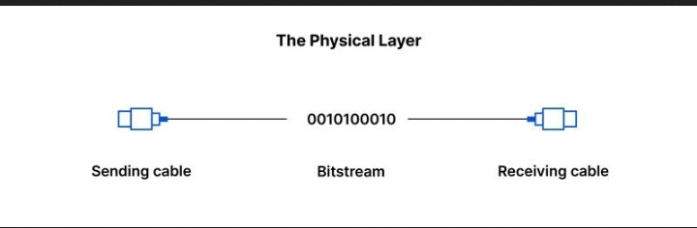
Techlators
Home
Service
About Us
Contact
PHYSICAL LAYER
Transmits Raw But stream
In charge of ensuring that network nodes are physically and wirelessly connected.
It describes the wireless technology, electrical cable, and connector used to connect the devices.
01
This includes hardware parts like cables and switches, as well as the electrical, optical, or radio signals delivered through them.
02

Slide 4
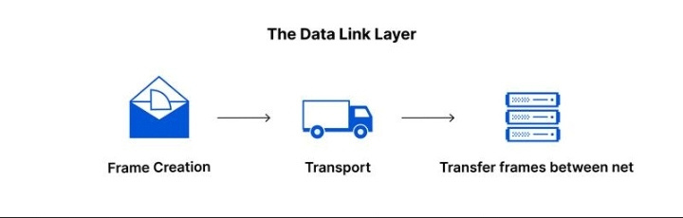
Techlators
Home
Service
About Us
Contact
DATA LINK LAYER
Format of Data on Network
Composed of two parts :
Logical Link Control (LLC)
Which identifies network protocols
Synchronizes frames and carries out error checks.
Media Access Control (MAC)
Which connects devices using Mac addresses and defines permissions to transmit and receive data.
Allows two physically connected nodes on a network to connect and disconnect.
Fragments of packets are broken up and sent from source to destination.
01
02

Slide 5
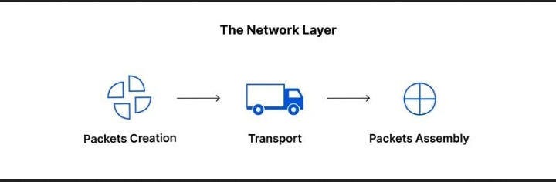
Techlators
Home
Service
About Us
Contact
NETWORKING LAYER
Decides the physical path of the Data
The segments are broken down into network packets and reassembled on the receiving end.
Routing packets by determining the optimal path over the physical network.
Network addresses are used to route packets to a destination node.
01
02

Slide 6
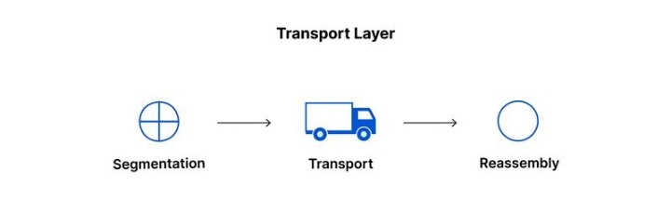
Techlators
Home
Service
About Us
Contact
TRANSPORT LAYER
Data Transmission using Transmission Protocols
Data from the session is later taken and broken down into parts on the transmitting end.
It is in charge of reassembling the segments at the receiving end into data for the session layer.
Carry out flow control, delivering data at the rate corresponding to the connection speed of receiving data, and error control.
01
02

Slide 7

Techlators
Home
Service
About Us
Contact
SESSION LAYER
Maintains Connection and Controls Ports
Sets up communication channels (sessions) between devices.
Responsible for session opening, ensuring session functionality throughout data transfer transmission, and session shutting when communication is complete.
Sets checkpoints during data transfer to prevent session disruption.
01
02

Slide 8
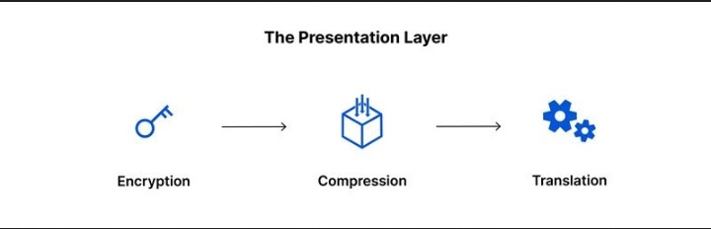
Techlators
Home
Service
About Us
Contact
PRESENTATION LAYER
Format and Encryption
Prepares data for the application layer.
Determines how two devices should encode and encrypt.
Compresses data correctly.
01
02

Slide 9
Techlators
Home
Service
About Us
Contact
APPLICATION LAYER
Human-computer interaction
End-user software like web browsers and email clients makes use of it.
Protocols are provided that allow software to send and receive information while also presenting useful data to users.
This layer supports protocols such as HTTP (HyperText Transfer Protocol), FTP (File Transfer Protocol), and SMTP (Simple Mail Transfer Protocol).
01
02

Slide 10
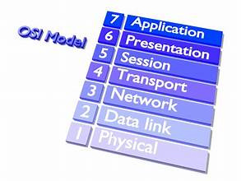
Techlators
Home
Service
About Us
Contact
SUMMARY
In a nutshell the OSI model provides a standardized method to networking, allowing various systems to communicate effectively by clearly specifying processes and functions at each of the seven layers. Each layer has certain tasks and interacts with adjacent layers to ensure that data is transmitted smoothly.
01
02

Slide 11
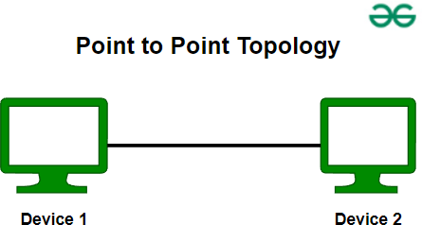
Techlators
Home
Service
About Us
Contact
TOPOLOGIES
1. Point-to-point Topology
Advantages of Point-to-Point Topology
Very simple to maintain. If a wire fails, you can replace it in a matter of seconds.
This topology is the simplest among network topologies.
Low-cost alternative when you have only two nodes to connect.
Disadvantages of Point-to-Point Topology
Only one link determines network performance. If the link fails, the entire network stops working.
There is just one server or client. If somebody fails, everything will cease working. You cannot take advantage of the network cluster. Not appropriate for any database servers.
01

Slide 12
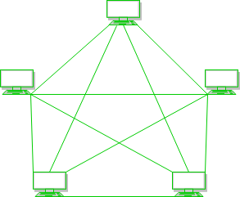
Home
Service
About Us
Contact
2. Mesh Topology
Advantages of Mesh Topology
Communication between nodes is extremely quick.
Offers security and privacy.
Disadvantages of Mesh Topology
Installation and configuration are challenging.
Cables are expensive since bulk wiring is necessary, hence they are best suited to fewer devices.
The cost of maintenance is significant.
01

Slide 13
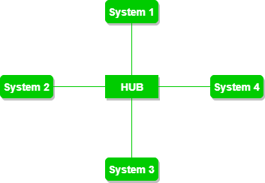
Home
Service
About Us
Contact
3. Star Topology
Advantages of Star Topology
It is robust. If one link fails, only that link will be affected, not the others.
Easy to identify and isolate faults.
The star topology is economical because it makes use of low-cost coaxial cable.
Disadvantages of Star Topology
If the concentrator (hub) on which the entire topology is based fails, the entire system will collapse.
The expense of installation is substantial.
Performance is based on a single concentrator, often known as a hub.
01

Slide 14
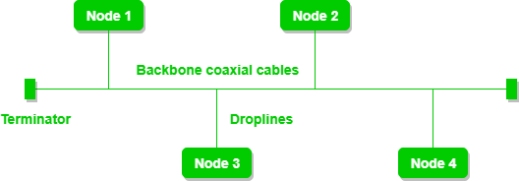
Home
Service
About Us
Contact
4. Bus Topology
Advantages of Bus Topology
Bus topology is a well-known technology in terms of installation and troubleshooting.
CSMA (Carrier Sense Multiple Access) is the most used approach for this topology.
Disadvantages of Bus Topology
A bus topology is simpler, but it still requires a lot of cabling.
If the common wire fails, the entire system will collapse.
Heavy network traffic leads to more network collisions. To avoid this, the MAC layer employs protocols such as Pure Aloha, Slotted Aloha, CSMA/CD, and others.
01

Slide 15
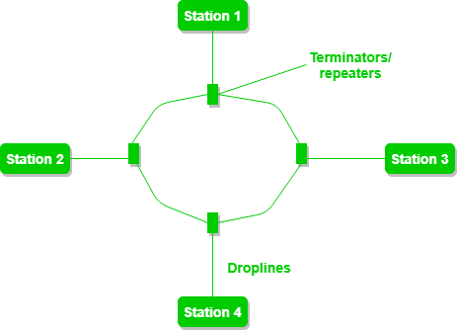
Home
Service
About Us
Contact
5. Ring Topology
Advantages of Ring Topology
The data transmission is quite fast.
It is inexpensive to install and expand.
It's less expensive than the star topology.
Disadvantages of Ring Topology
A single node failure in the network might bring the entire network down.
Troubleshooting is challenging in this topology.
It is less secure.
01

Slide 16
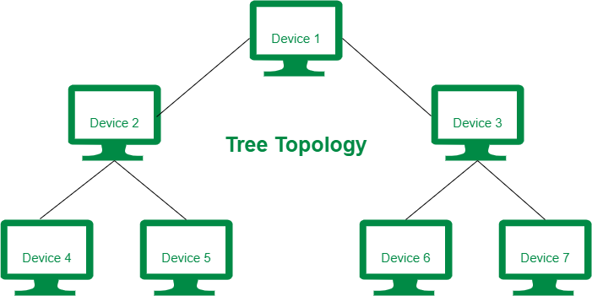
Home
Service
About Us
Contact
6. Tree Topology
Advantages of Tree Topology
It allows more devices to be connected to a single central hub, reducing the distance travelled by the signal to reach the devices.
We can connect new devices to the existing network.
Error detection and rectification are fairly simple with a tree topology.
Disadvantages of Tree Topology
If the central hub fails, the whole system fails.
The high expense is due to the cabling.
When new devices are added, reconfiguration becomes more complicated.

Slide 17
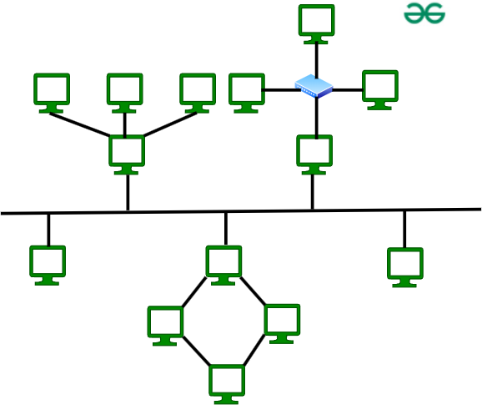
Home
Service
About Us
Contact
7. Hybrid Topology
Advantages of Hybrid Topology
This topology has a high degree of flexibility.
The network can be simply expanded by adding new devices.
Disadvantages of Hybrid Topology
It is difficult to develop the architecture of the Hybrid Network.
The hubs used in this topology are quite expensive.
A hybrid network necessitates extensive cabling and network devices, which raises the infrastructure cost significantly.

Slide 18


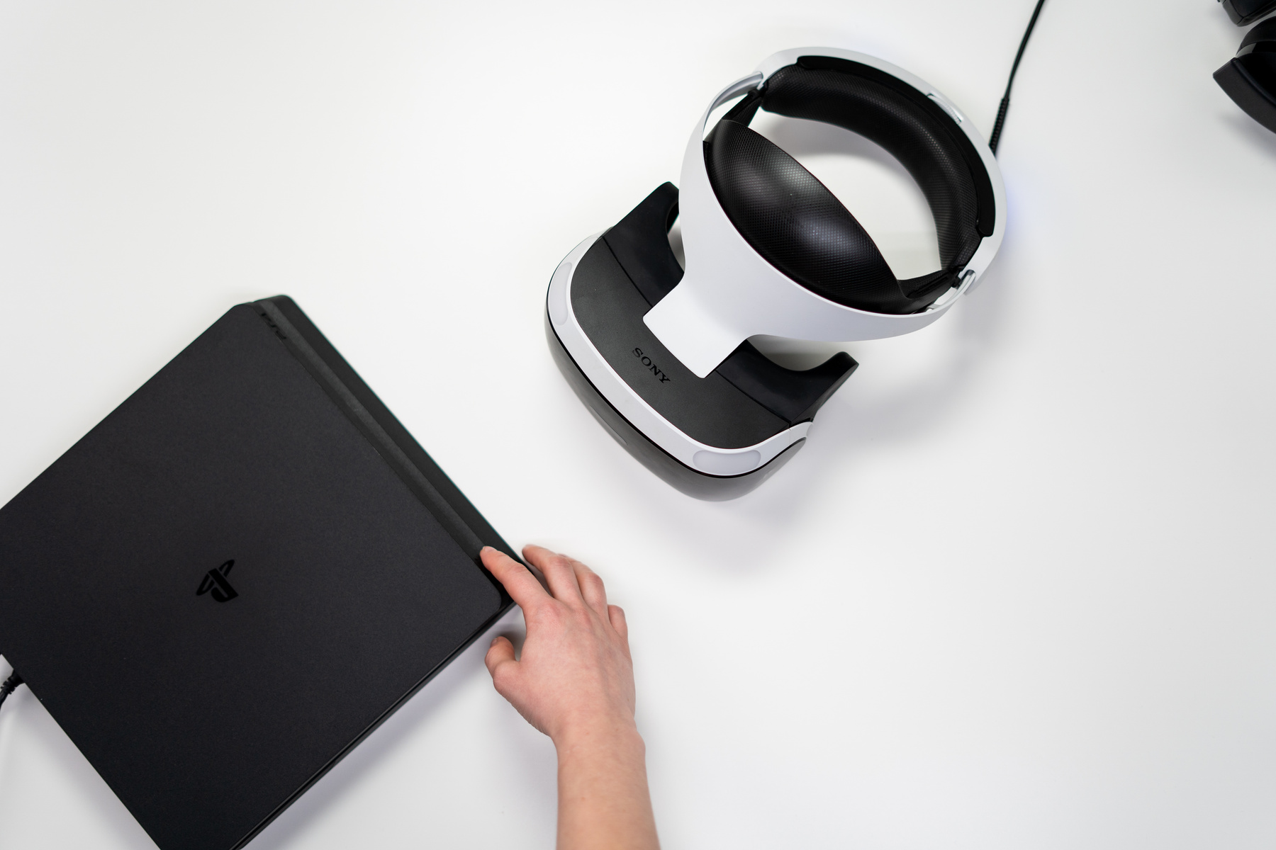
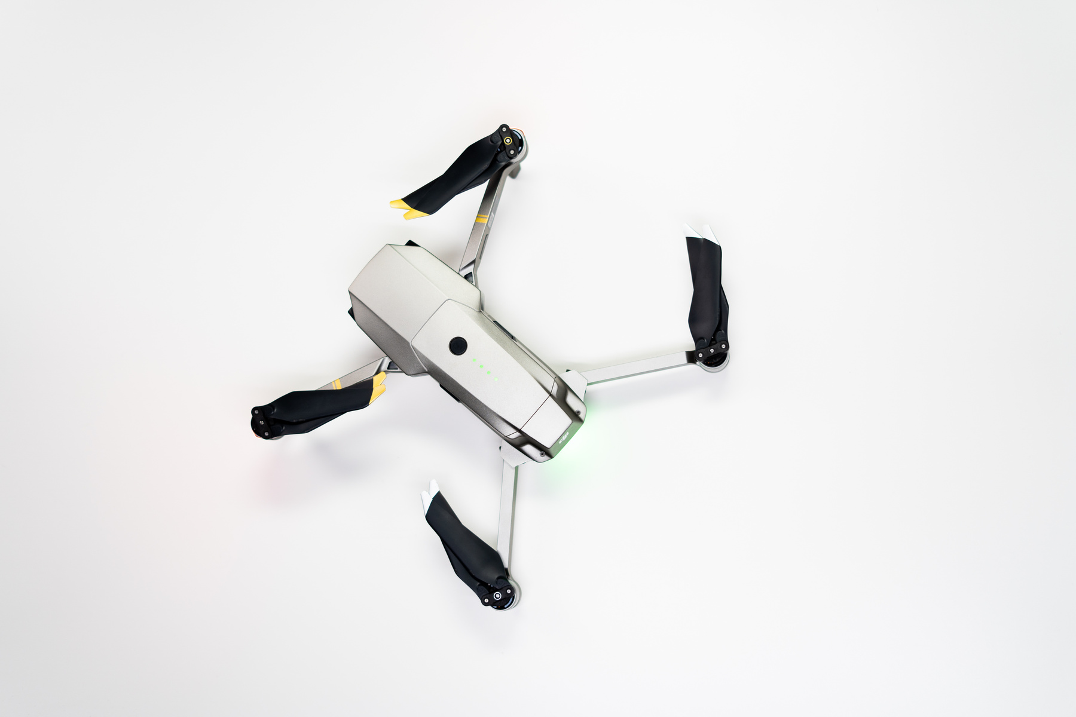
Techlators
Home
Service
About Us
Contact
SUMMARY
In summary, the choice of network topology is determined by several criteria, including network size, necessary performance, financial limits, and reliability requirements. Each topology has distinct strengths and drawbacks, which can make it appropriate for certain contexts while restricting its efficacy in others. Understanding these qualities is critical to creating a network that serves its intended purpose.

Slide 19
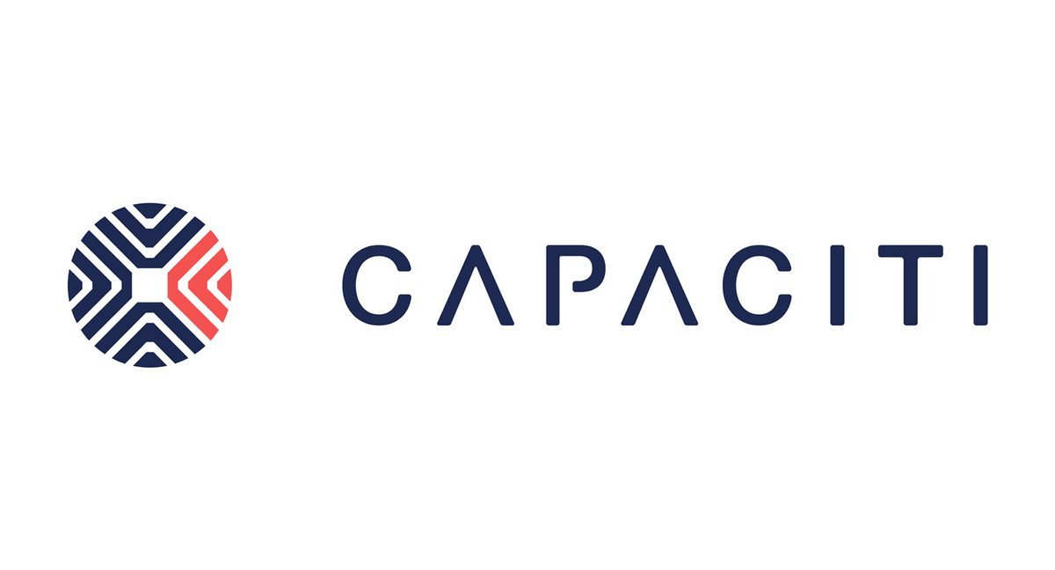



Techlators
Home
Service
About Us
Contact
CONTACT US
0643677470
hello@capaciti.org.za
mandla.nyembe@capaciti.org.za
Johannesburg

Slide 20
Techlators
Home
Service
About Us
Contact
THANK YOU

